Slide 1
UniFormer & UniFormerV2
Paper Summary
Notes:
Conference on Neuron Information Processing Systems

Slide 2
References
Kunchang Li et al - ShenZhen Key Lab of Computer Vision and Pattern Recognition, SIAT-SenseTime Joint Lab, Shenzhen Institute of Advanced Technology, Chinese Academy of Sciences:
UniFormer: Unified Transformer for Efficient Spatiotemporal Representation Learning, ICLR 2022.
UniFormer: Unifying Convolution and Self-attention for Visual Recognition, Submitted to TPAMI, 2022.
UniFormerV2: Spatiotemporal Learning by Arming Image ViTs with Video UniFormer, Under review at ICLR 2023.

Slide 3
UniFormer
Unified transFormer

Slide 4
Introduction
2 challenges in visual feature learning:
Large local redundancy: visual content in local region (space, time or space-time) tends to be similar → Inefficient computation.
Complex global dependency: targets in different regions have dynamic relations → Ineffective learning.

Slide 5
Introduction
Approaches:
CNNs / 3D CNNs:
Convolution is good at reducing local redundancy.
Limited receptive field causes difficulty in learning global dependency.
ViTs:
Self-attention is strong at learning global dependency in both images and videos.
Redundant global attention is inefficient to encode local features in the shallow layers.

Slide 6
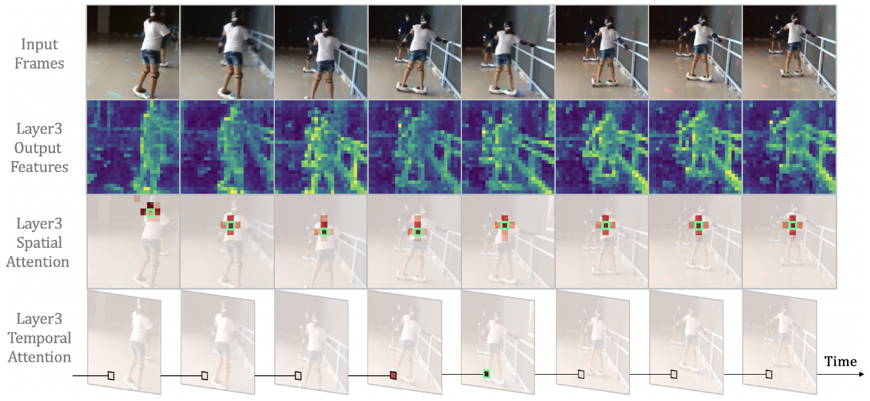
Introduction
→ ViTs spend large computation to encode only very local spatiotemporal representations.

Slide 7
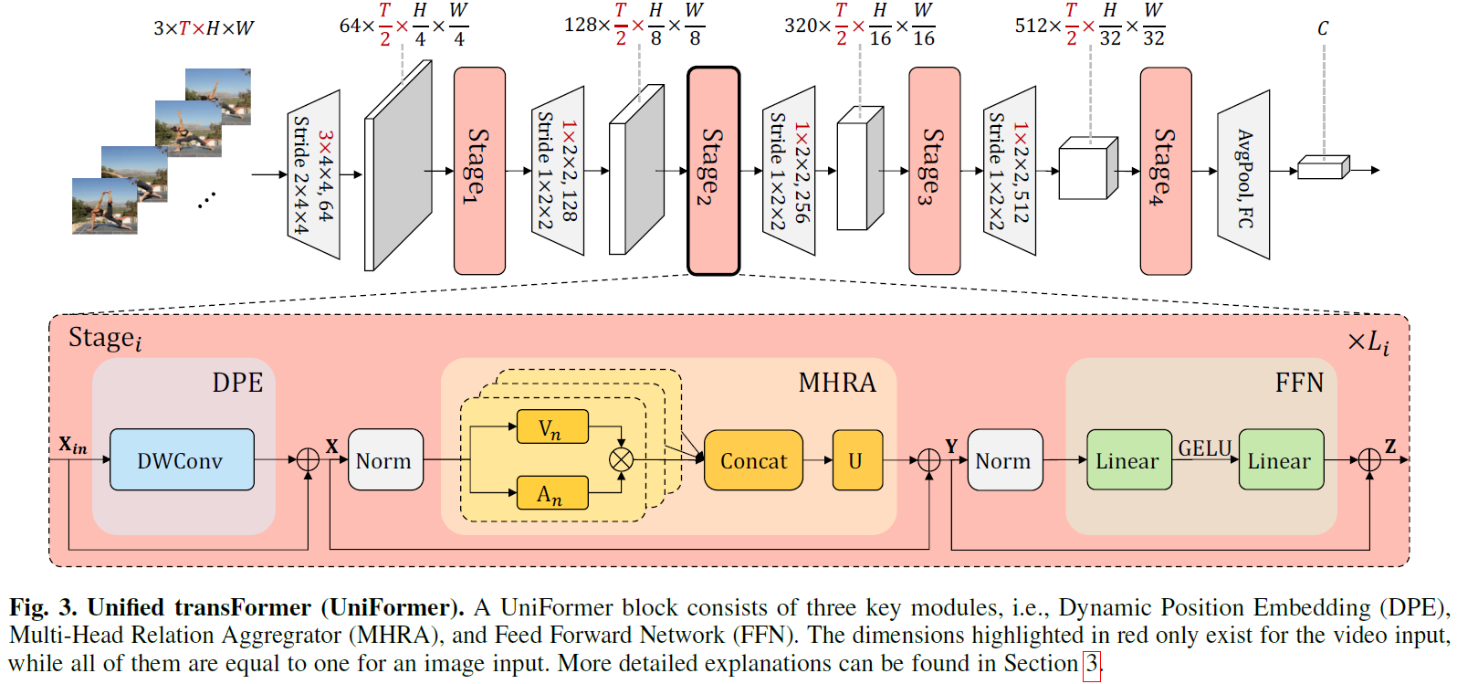
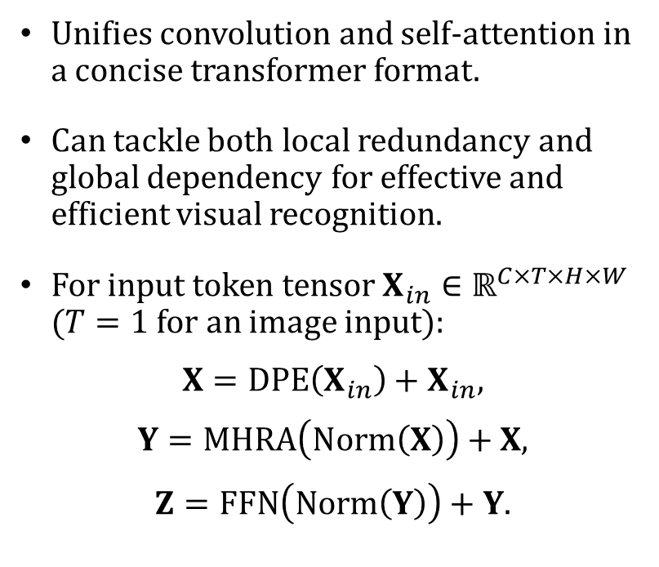
UniFormer
Unifies convolution and self-attention in a concise transformer format.
Can tackle both local redundancy and global dependency for effective and efficient visual recognition.
For input token tensor $X_{in}∈ℝ^{C×T×H×W}$ ($T=1$for an image input):
$$X=DPE\left(X_{in}\right)+X_{in},$$
$$Y=MHRA\left(Norm\left(X\right)\right)+X,$$
$$Z=FFN\left(Norm\left(Y\right)\right)+Y\text{.}$$

Slide 8
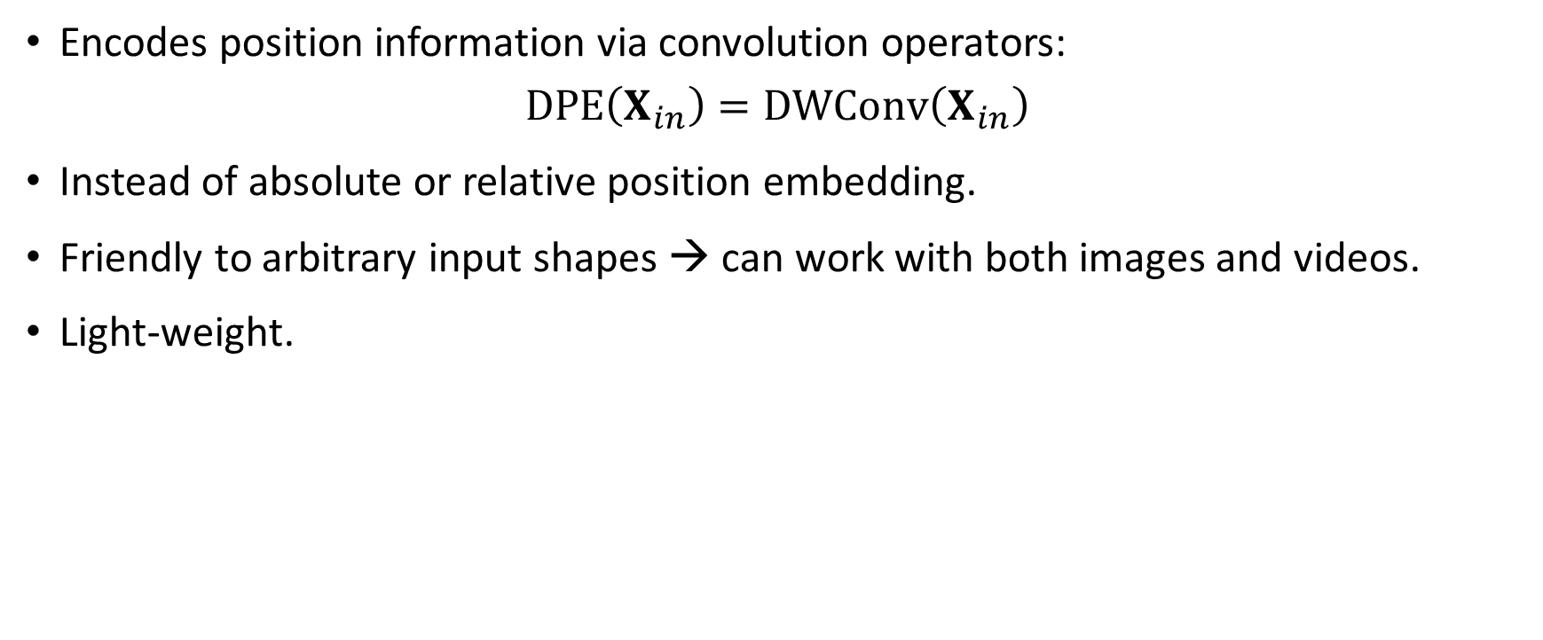
Dynamic Position Embedding
Encodes position information via convolution operators:
$$DPE\left(X_{in}\right)=DWConv\left(X_{in}\right)$$
Instead of absolute or relative position embedding.
Friendly to arbitrary input shapes → can work with both images and videos.
Light-weight.

Slide 9
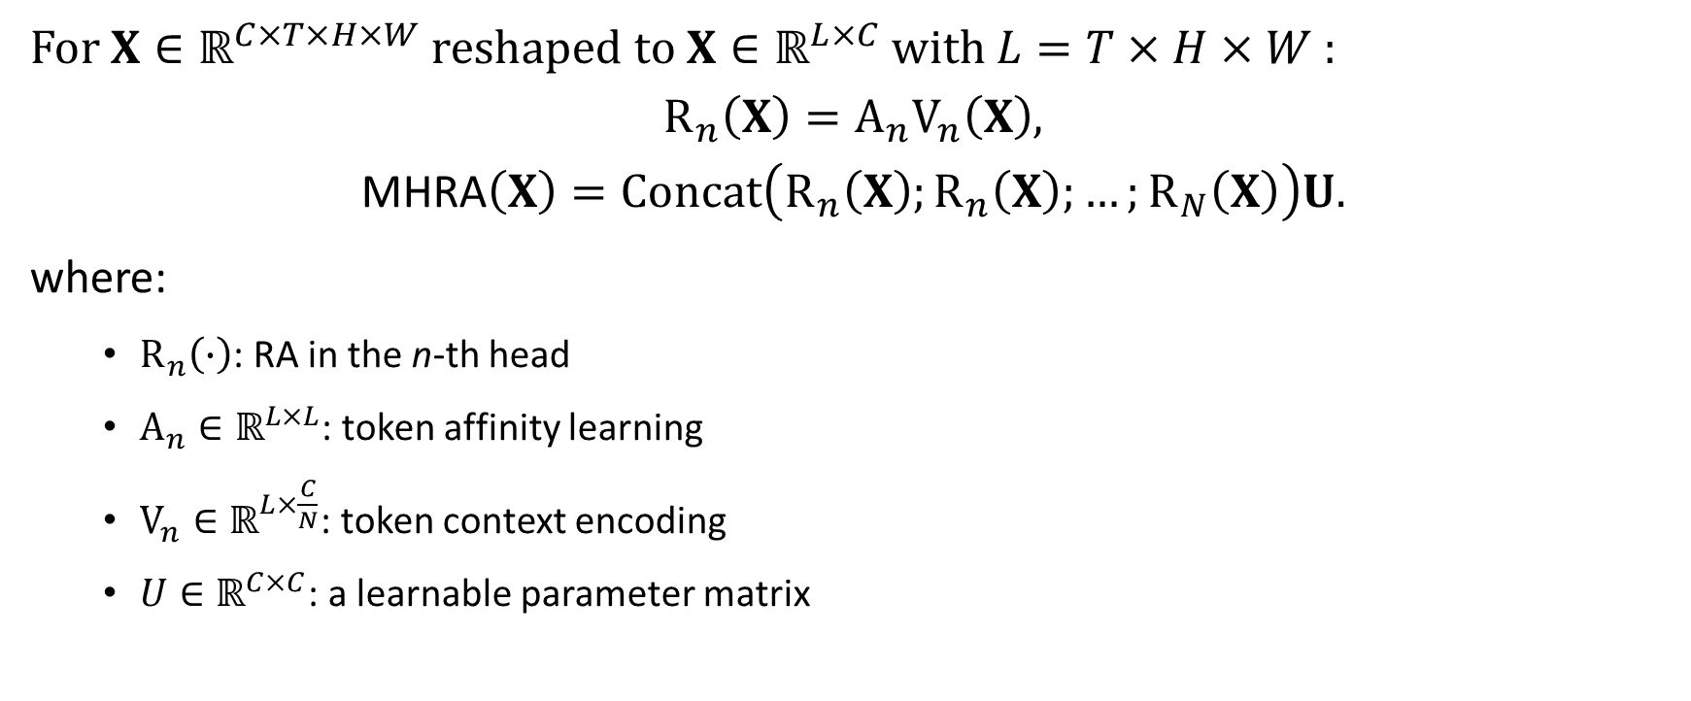
Multi-Head Relation Aggregator
For $X∈ℝ^{C×T×H×W}$ reshaped to $X∈ℝ^{L×C}$ with $L=T×H×W$ :
$$R_{n}\left(X\right)=A_{n}V_{n}\left(X\right),$$
$$\text{MHRA}\left(X\right)=Concat\left(R_{n}\left(X\right);R_{n}\left(X\right);…;R_{N}\left(X\right)\right)U.$$
where:
$R_{n}\left(∙\right)$: RA in the n-th head
$A_{n}∈ℝ^{L×L}$: token affinity learning
$V_{n}∈ℝ^{L×\frac{C}{N}}$: token context encoding
$U∈ℝ^{C×C}$: a learnable parameter matrix

Slide 10
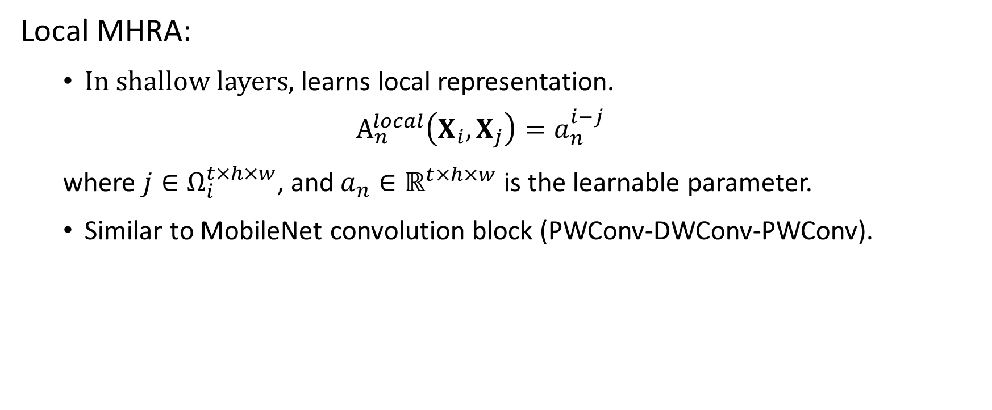
Multi-Head Relation Aggregator
Local MHRA:
In shallow layers, learns local representation.
$$A_{n}^{local}\left(X_{i},X_{j}\right)=a_{n}^{i−j}$$
where $j∈Ω_{i}^{t×h×w}$, and $a_{n}∈ℝ^{t×h×w}$ is the learnable parameter.
Similar to MobileNet convolution block (PWConv-DWConv-PWConv).

Slide 11
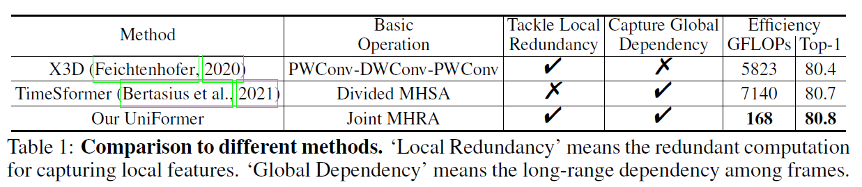
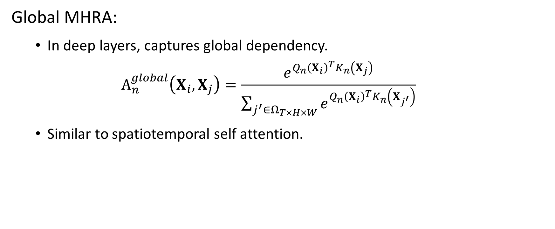
Multi-Head Relation Aggregator
Global MHRA:
In deep layers, captures global dependency.
$$A_{n}^{global}\left(X_{i},X_{j}\right)=\frac{e^{Q_{n}{\left(X_{i}\right)}^{T}K_{n}\left(X_{j}\right)}}{\sum_{j^{′}∈Ω_{T×H×W}}{e^{Q_{n}{\left(X_{i}\right)}^{T}K_{n}\left(X_{j^{′}}\right)}}}$$
Similar to spatiotemporal self attention.

Slide 12
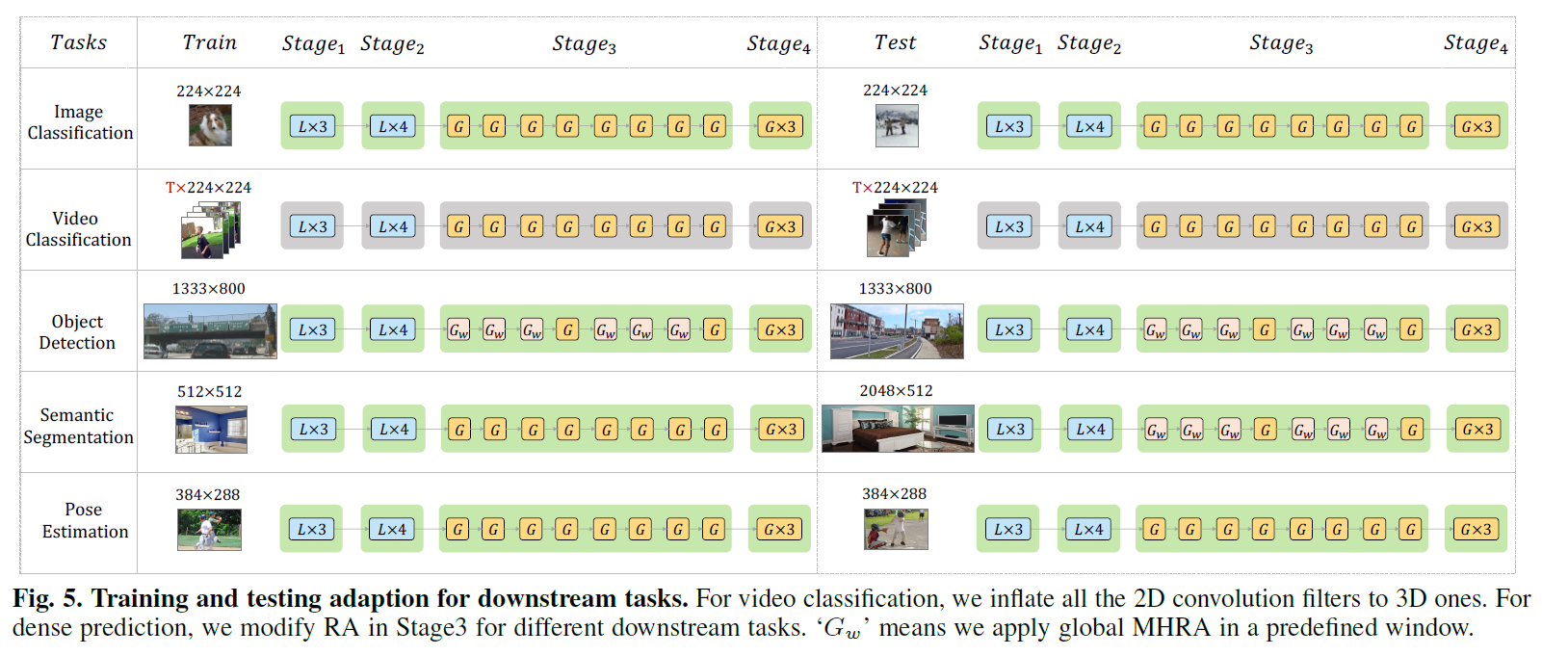
Framework

Slide 13
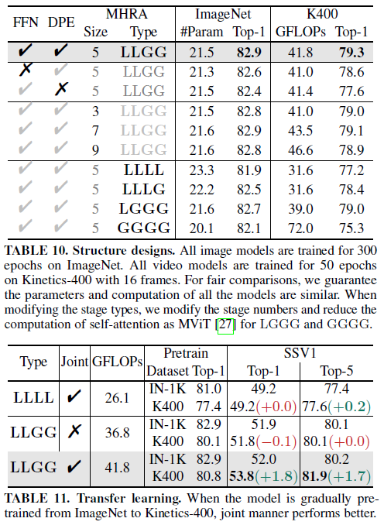
Ablation

Slide 14
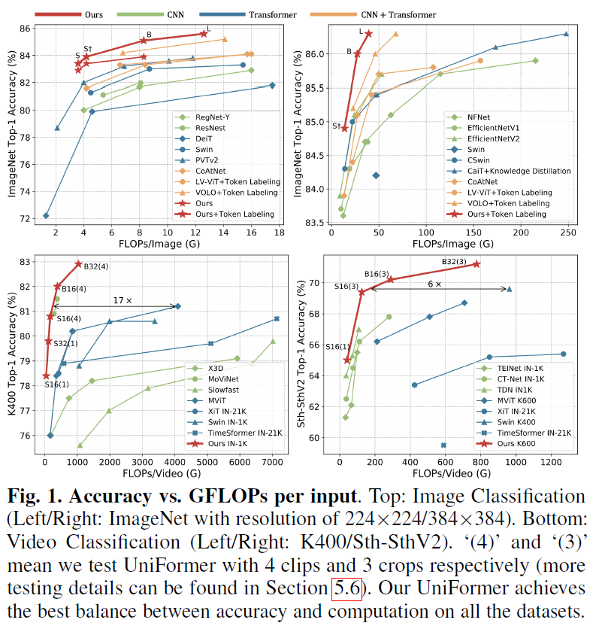
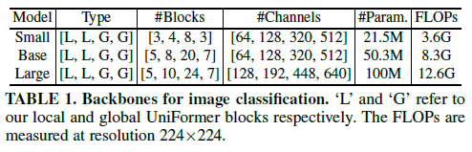
Image Classification

Slide 15
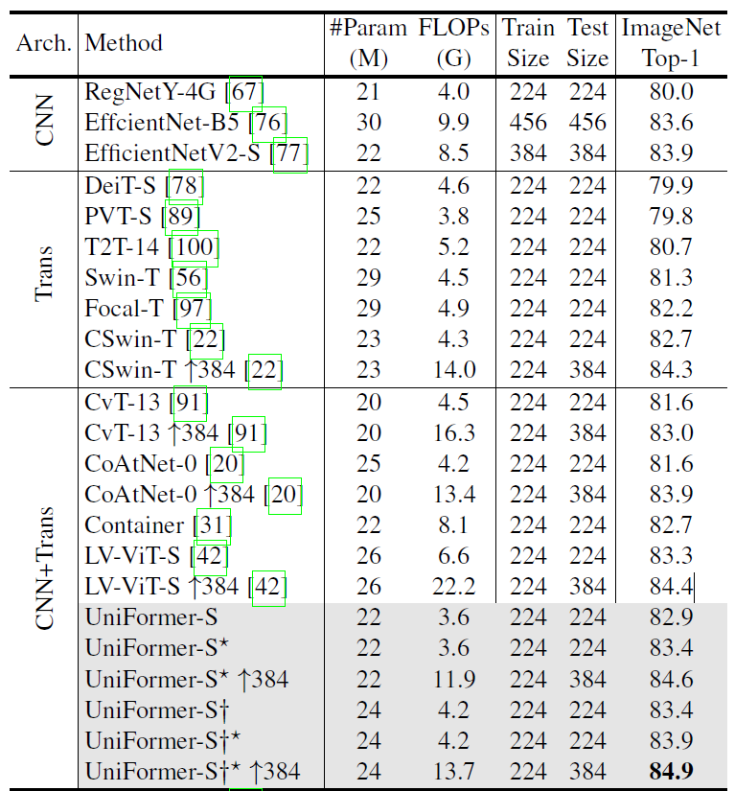
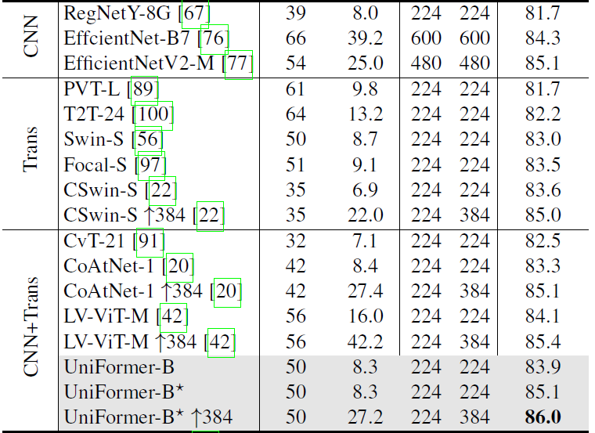
Image Classification

Slide 16
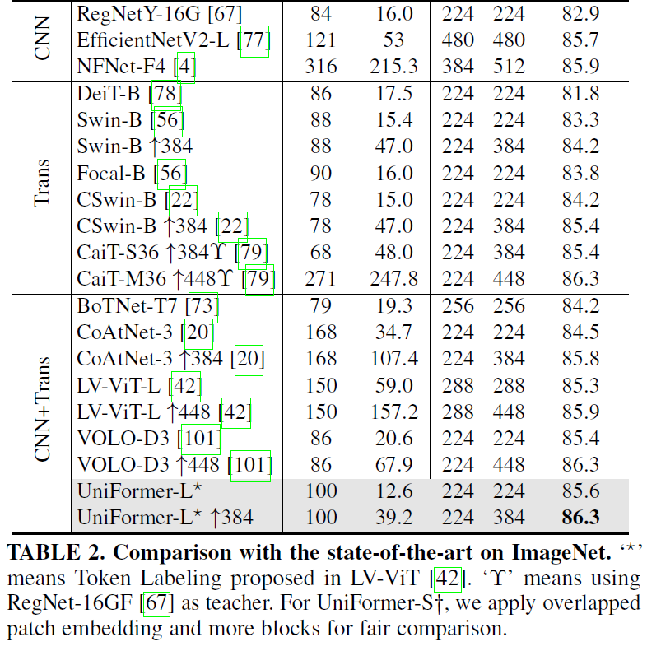
Image Classification

Slide 17
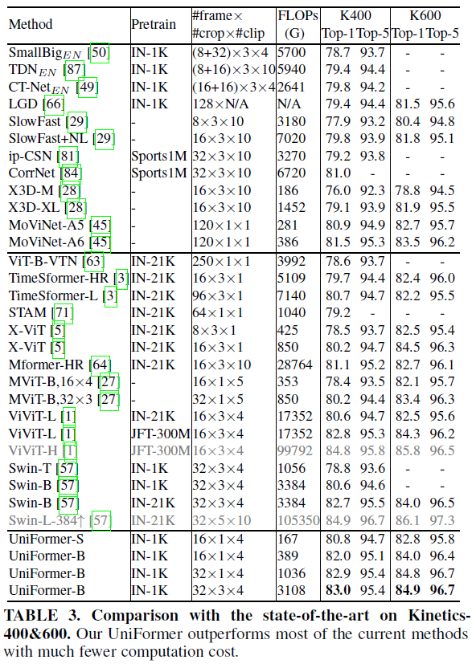
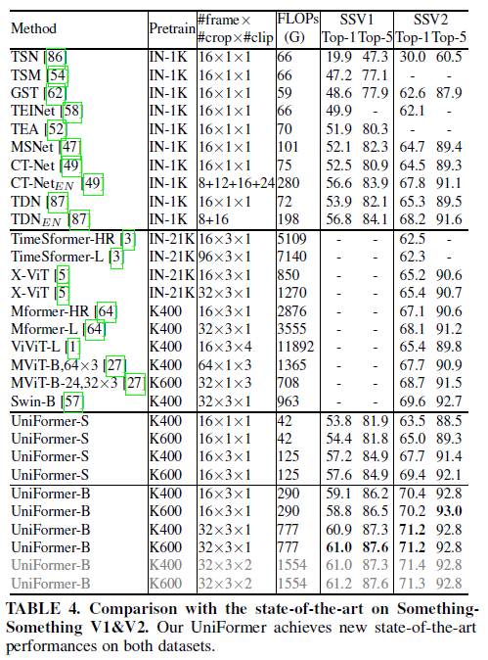
Video Action Recognition

Slide 18
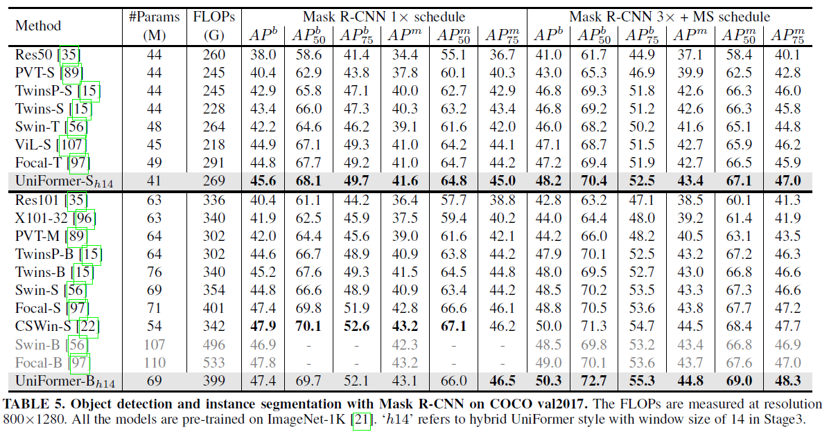
Object Detection

Slide 19
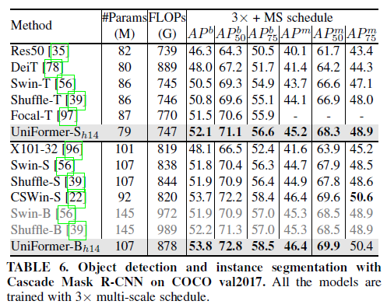
Object Detection

Slide 20
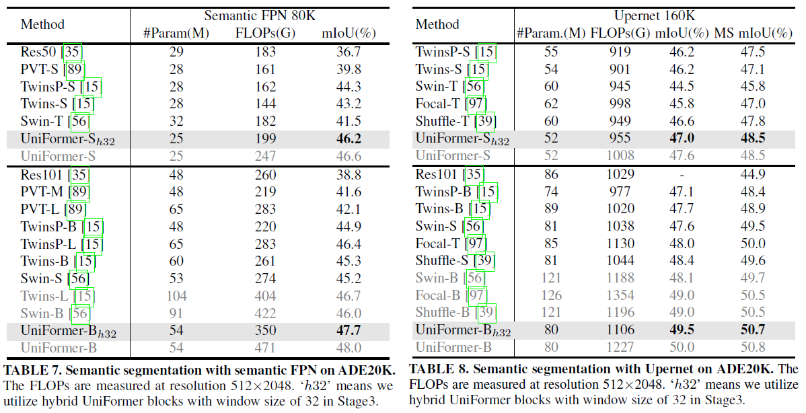
Semantic Segmentation

Slide 21
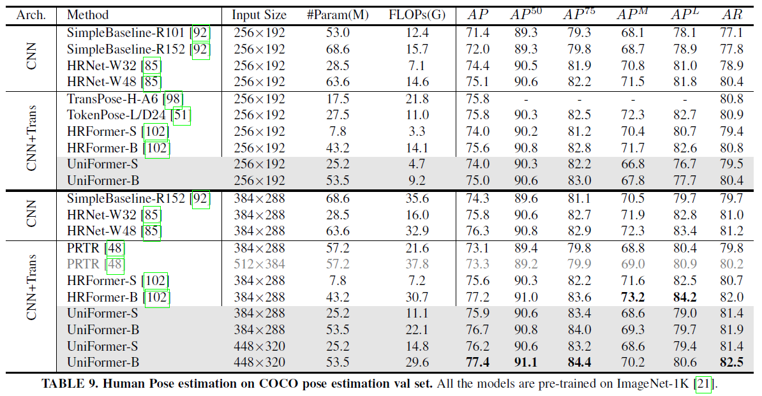
Human Pose Estimation

Slide 22
UniFormerV2

Slide 23
Introduction
For video understanding tasks, new architecture UniFormer does not have any image-based pretraining as a start.
→ Requires tedious supervised pretraining phase before finetuning on videos.
→ UniFormerV2: arming the image-pretrained ViTs with efficient video designs of UniFormer.

Slide 24
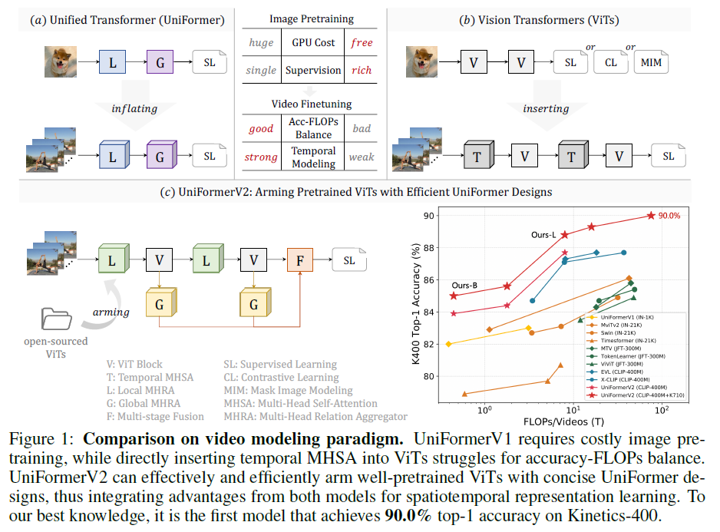
UniFormerV2

Slide 25
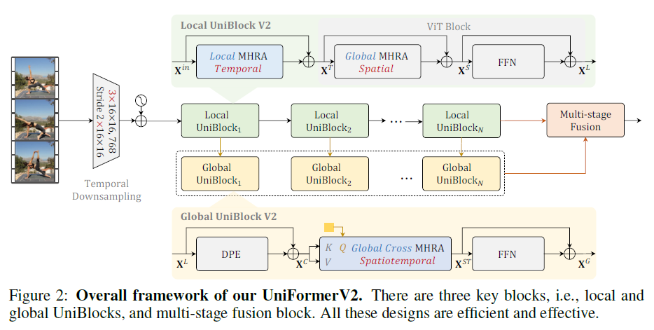
UniFormerV2

Slide 26
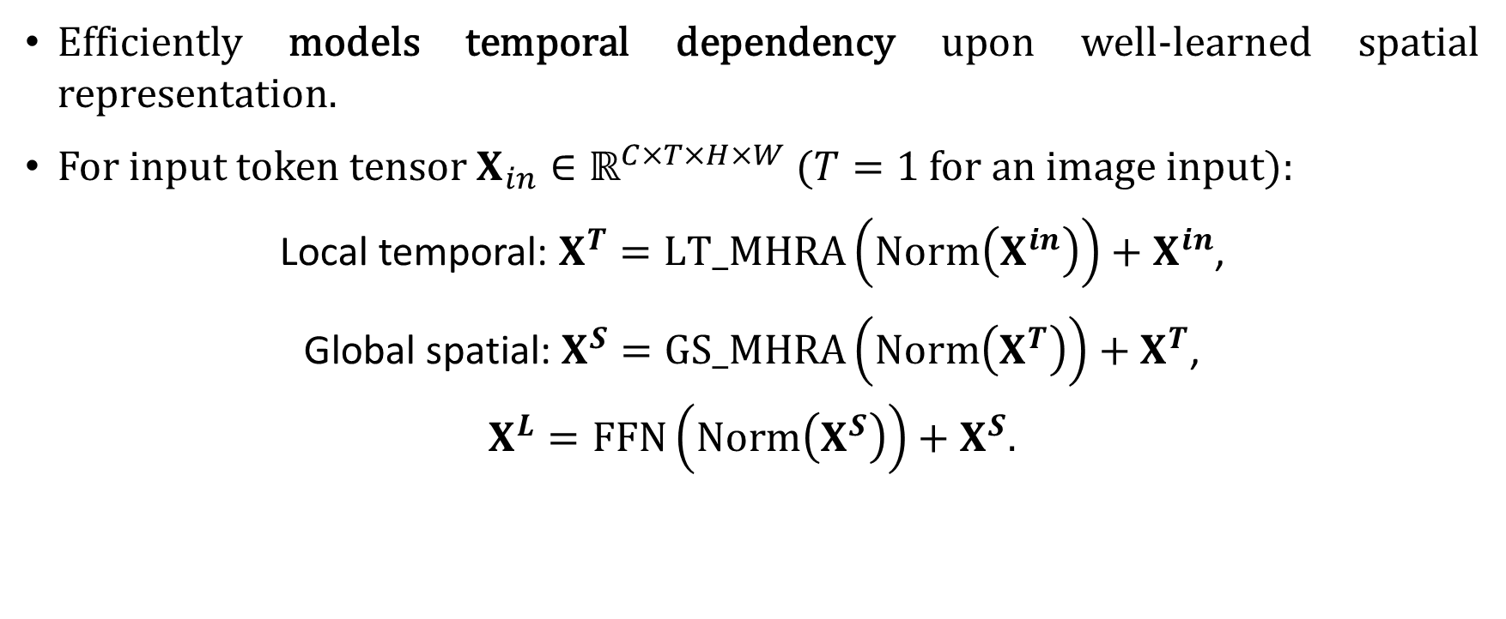
Local UniBlock
Efficiently models temporal dependency upon well-learned spatial representation.
For input token tensor $X_{in}∈ℝ^{C×T×H×W}$ ($T=1$for an image input):
Local temporal: $X^{T}=LT_MHRA\left(Norm\left(X^{in}\right)\right)+X^{in}$,
Global spatial: $X^{S}=GS_MHRA\left(Norm\left(X^{T}\right)\right)+X^{T}$,
$$X^{L}=FFN\left(Norm\left(X^{S}\right)\right)+X^{S}\text{.}$$

Slide 27
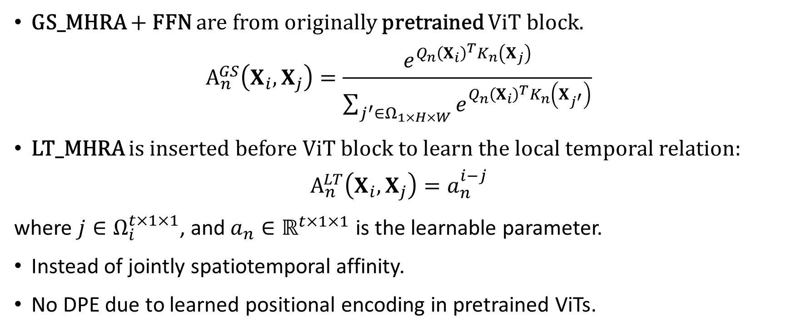
Local UniBlock
GS_MHRA + FFN are from originally pretrained ViT block.
$$A_{n}^{GS}\left(X_{i},X_{j}\right)=\frac{e^{Q_{n}{\left(X_{i}\right)}^{T}K_{n}\left(X_{j}\right)}}{\sum_{j^{′}∈Ω_{1×H×W}}{e^{Q_{n}{\left(X_{i}\right)}^{T}K_{n}\left(X_{j^{′}}\right)}}}$$
LT_MHRA is inserted before ViT block to learn the local temporal relation:
$$A_{n}^{LT}\left(X_{i},X_{j}\right)=a_{n}^{i−j}$$
where $j∈Ω_{i}^{t×1×1}$, and $a_{n}∈ℝ^{t×1×1}$ is the learnable parameter.
Instead of jointly spatiotemporal affinity.
No DPE due to learned positional encoding in pretrained ViTs.

Slide 28
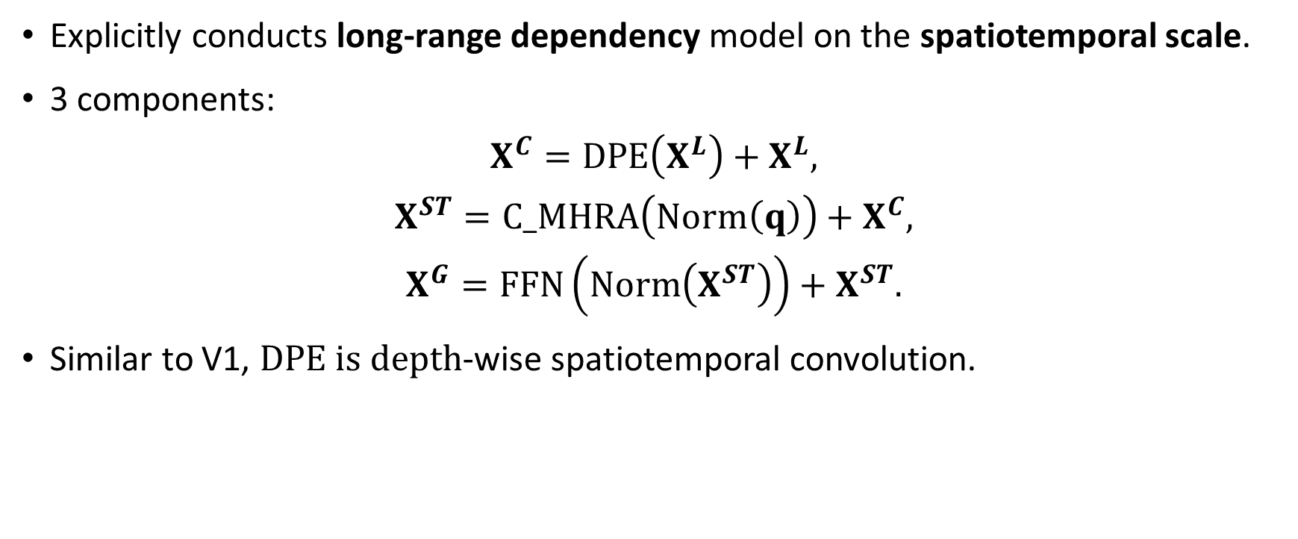
Global UniBlock
Explicitly conducts long-range dependency model on the spatiotemporal scale.
3 components:
$$X^{C}=DPE\left(X^{L}\right)+X^{L},$$
$$X^{ST}=C_MHRA\left(Norm\left(q\right)\right)+X^{C},$$
$$X^{G}=FFN\left(Norm\left(X^{ST}\right)\right)+X^{ST}\text{.}$$
Similar to V1, $DPE is depth$-wise spatiotemporal convolution.

Slide 29
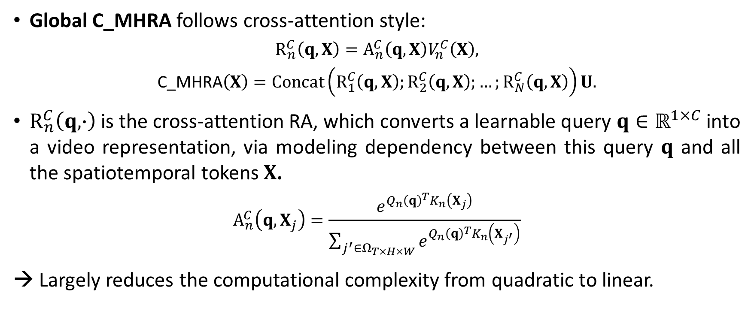
Global UniBlock
Global C_MHRA follows cross-attention style:
$$R_{n}^{C}\left(q,X\right)=A_{n}^{C}\left(q,X\right)V_{n}^{C}\left(X\right),$$
$$\text{C}\text{_}\text{MHRA}\left(X\right)=Concat\left(R_{1}^{C}\left(q,X\right);R_{2}^{C}\left(q,X\right);…;R_{N}^{C}\left(q,X\right)\right)U.$$
$R_{n}^{C}\left(q,∙\right)$ is the cross-attention RA, which converts a learnable query $q∈ℝ^{1×C}$ into a video representation, via modeling dependency between this query $q$ and all the spatiotemporal tokens $X$.
$$A_{n}^{C}\left(q,X_{j}\right)=\frac{e^{Q_{n}{\left(q\right)}^{T}K_{n}\left(X_{j}\right)}}{\sum_{j^{′}∈Ω_{T×H×W}}{e^{Q_{n}{\left(q\right)}^{T}K_{n}\left(X_{j^{′}}\right)}}}$$
→ Largely reduces the computational complexity from quadratic to linear.

Slide 30
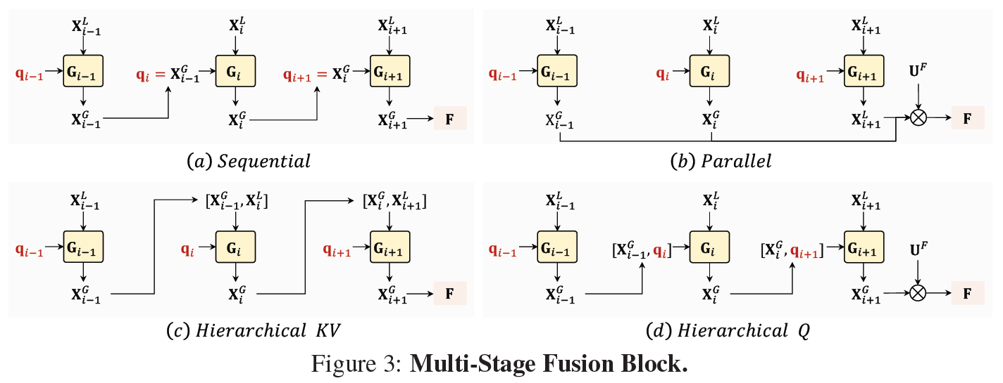
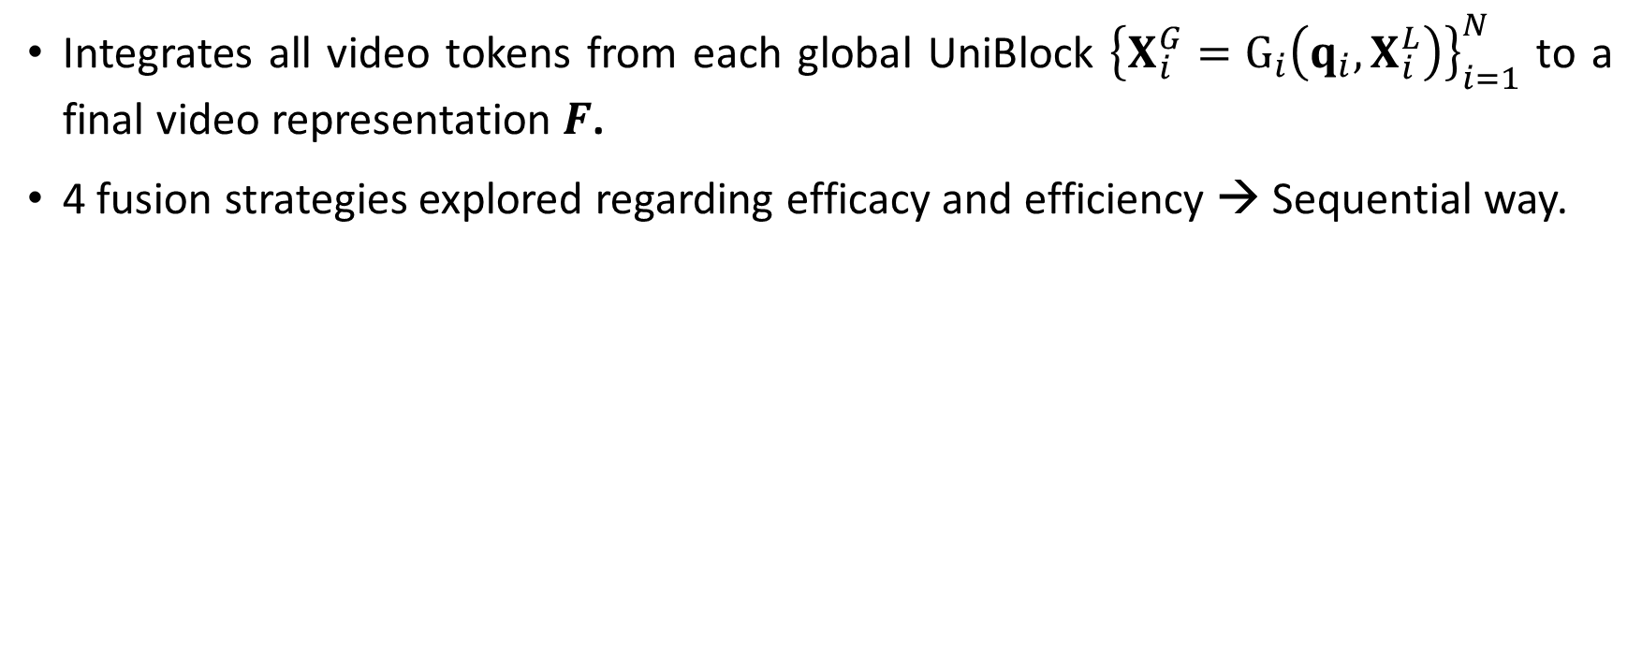
Multi-Stage Fusion Block
Integrates all video tokens from each global UniBlock ${\left\{X_{i}^{G}=G_{i}\left(q_{i},X_{i}^{L}\right)\right\}}_{i=1}^{N}$ to a final video representation $F$.
4 fusion strategies explored regarding efficacy and efficiency → Sequential way.

Slide 31
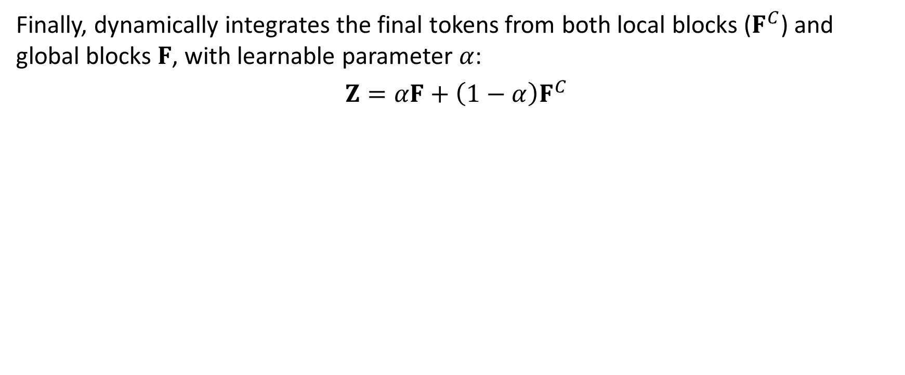
Multi-Stage Fusion Block
Finally, dynamically integrates the final tokens from both local blocks ($F^{C}$) and global blocks $F$, with learnable parameter $α$:
$$Z=αF+{\left(1−α\right)F}^{C}$$

Slide 32
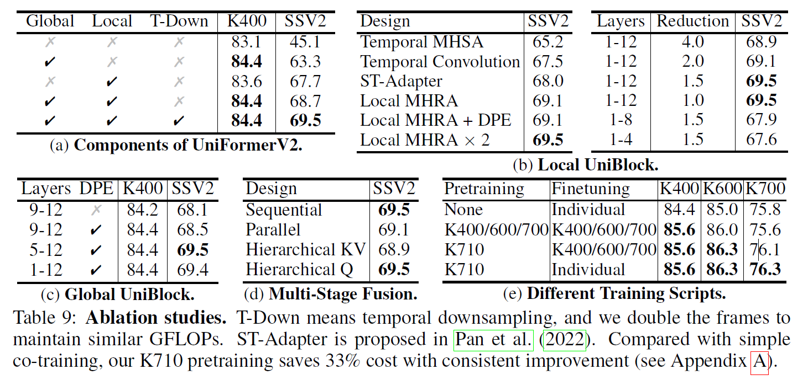
Ablation

Slide 33
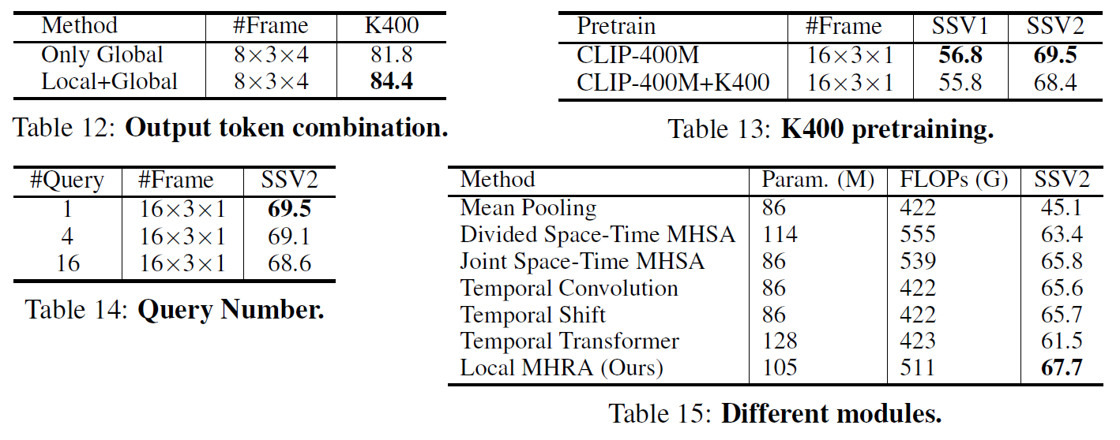
Ablation

Slide 34
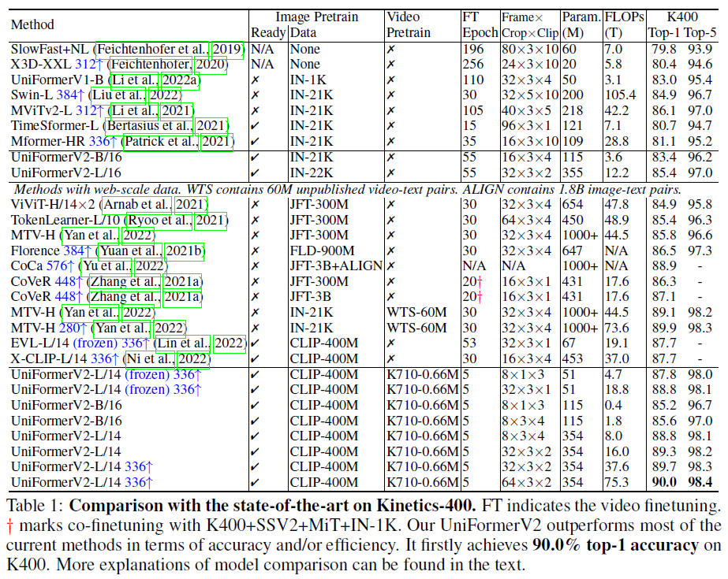
Video Action Recognition

Slide 35
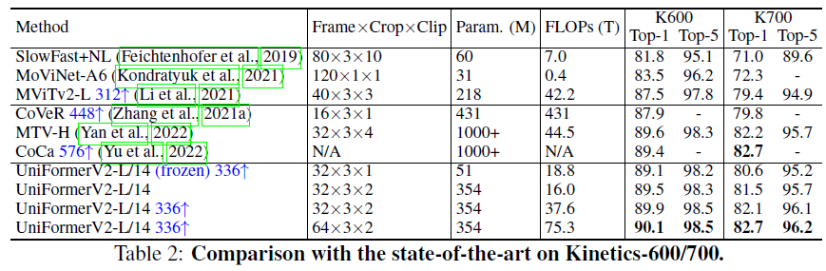
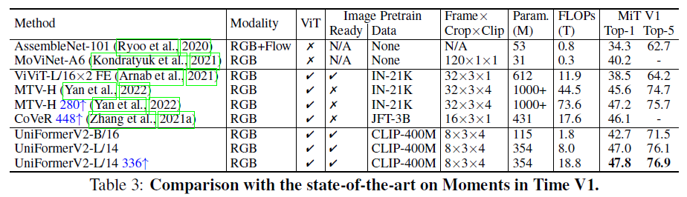
Video Action Recognition

Slide 36
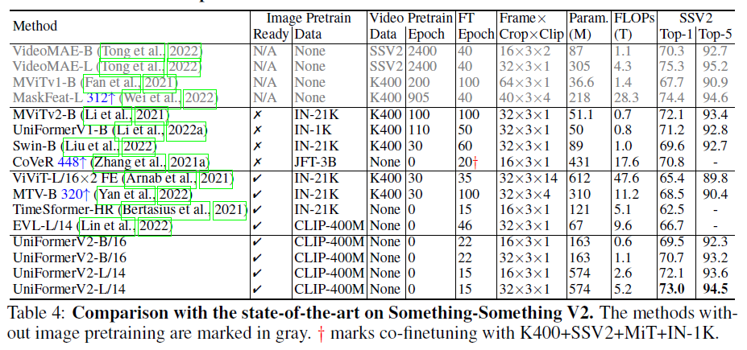
Video Action Recognition

Slide 37
Conclusion
UniFormer:
Effectively unifies convolution and self-attention in a concise transformer format to overcome redundancy and dependency.
Adopts local MHRA in shallow layers to largely reduce computation burden and global MHRA in deep layers to learn global token relation.
UniFormerV2:
Arms image-pretrained ViTs with efficient UniFormer designs for video learning.
Capable of conducting effective spatiotemporal modeling with a tractable complexity by local and global video relation aggregators.
Introduces multi-scale token fusion for further enhancing video representation.

Slide 38
Thank you for your attention

